Slide 1

Commissioning of Synchronous Generator or Alternator to determine synchronous reactance with protection management. .
Presented by
Eng. Diponkar Paul
BSc. Engg. (RUETE), MS Engg. (NTU-SG)
EEE Assoc/Prof. & IT professional.

Slide 2
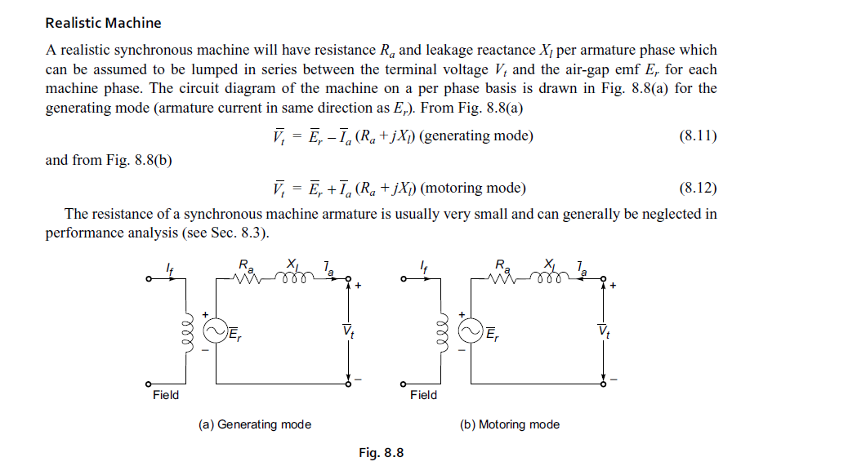
Objectives
o To discuss the realistic model of synchronous machine model
To To determine the synchronous reactance by using OCC & SC. For the calculation of synchronous reactance.
To study & design differential protection for alternators.

Slide 3
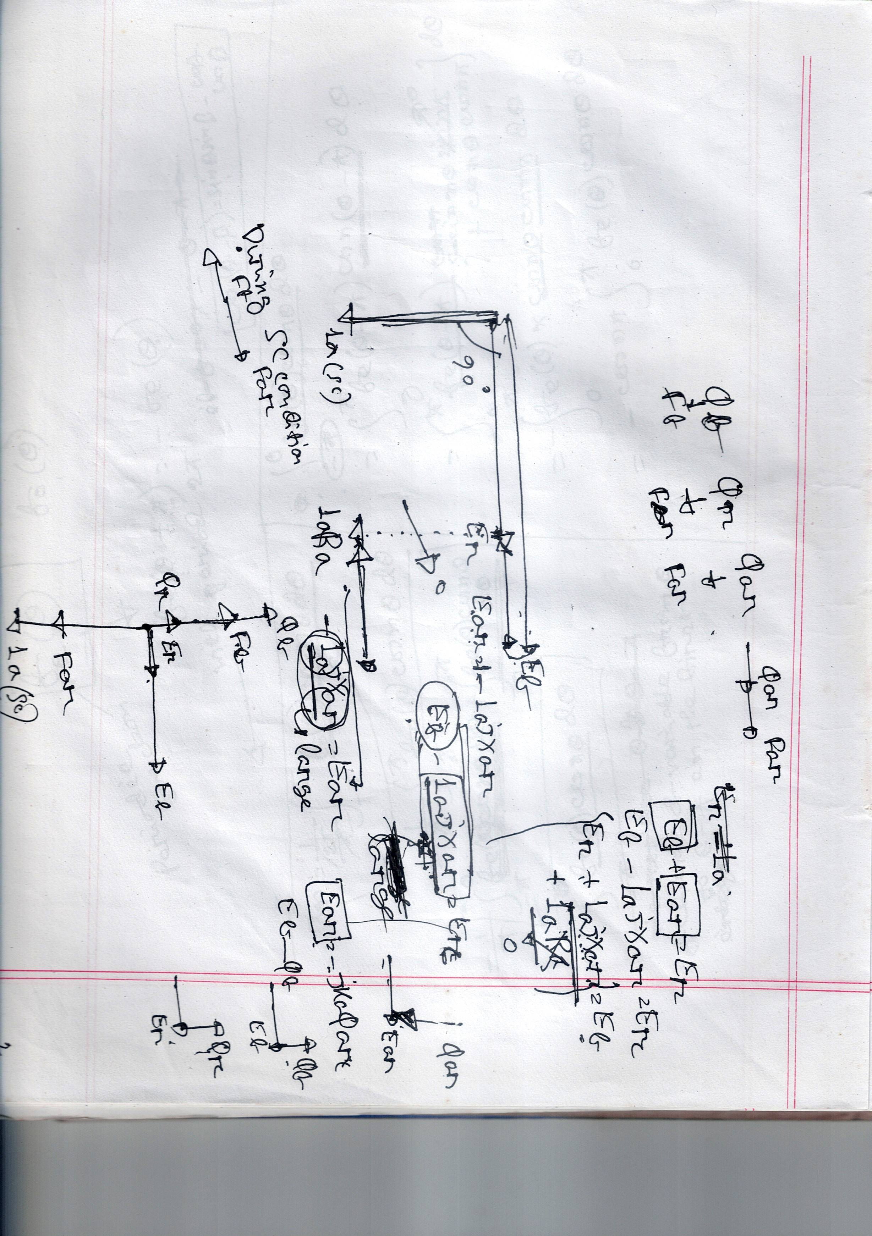

Slide 4
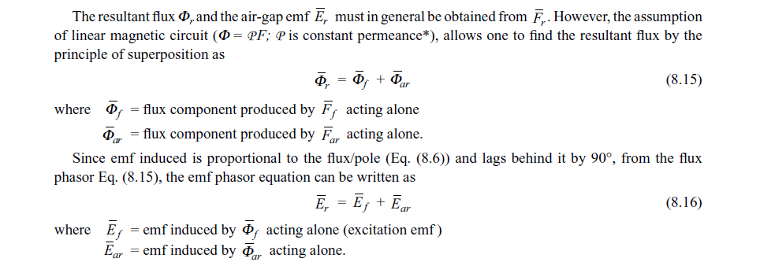
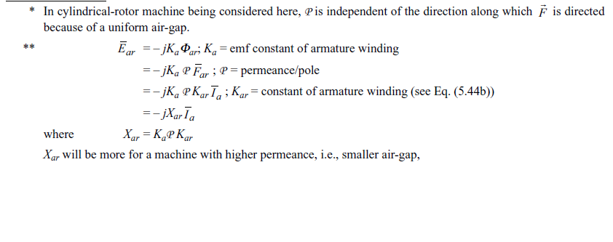

Slide 5
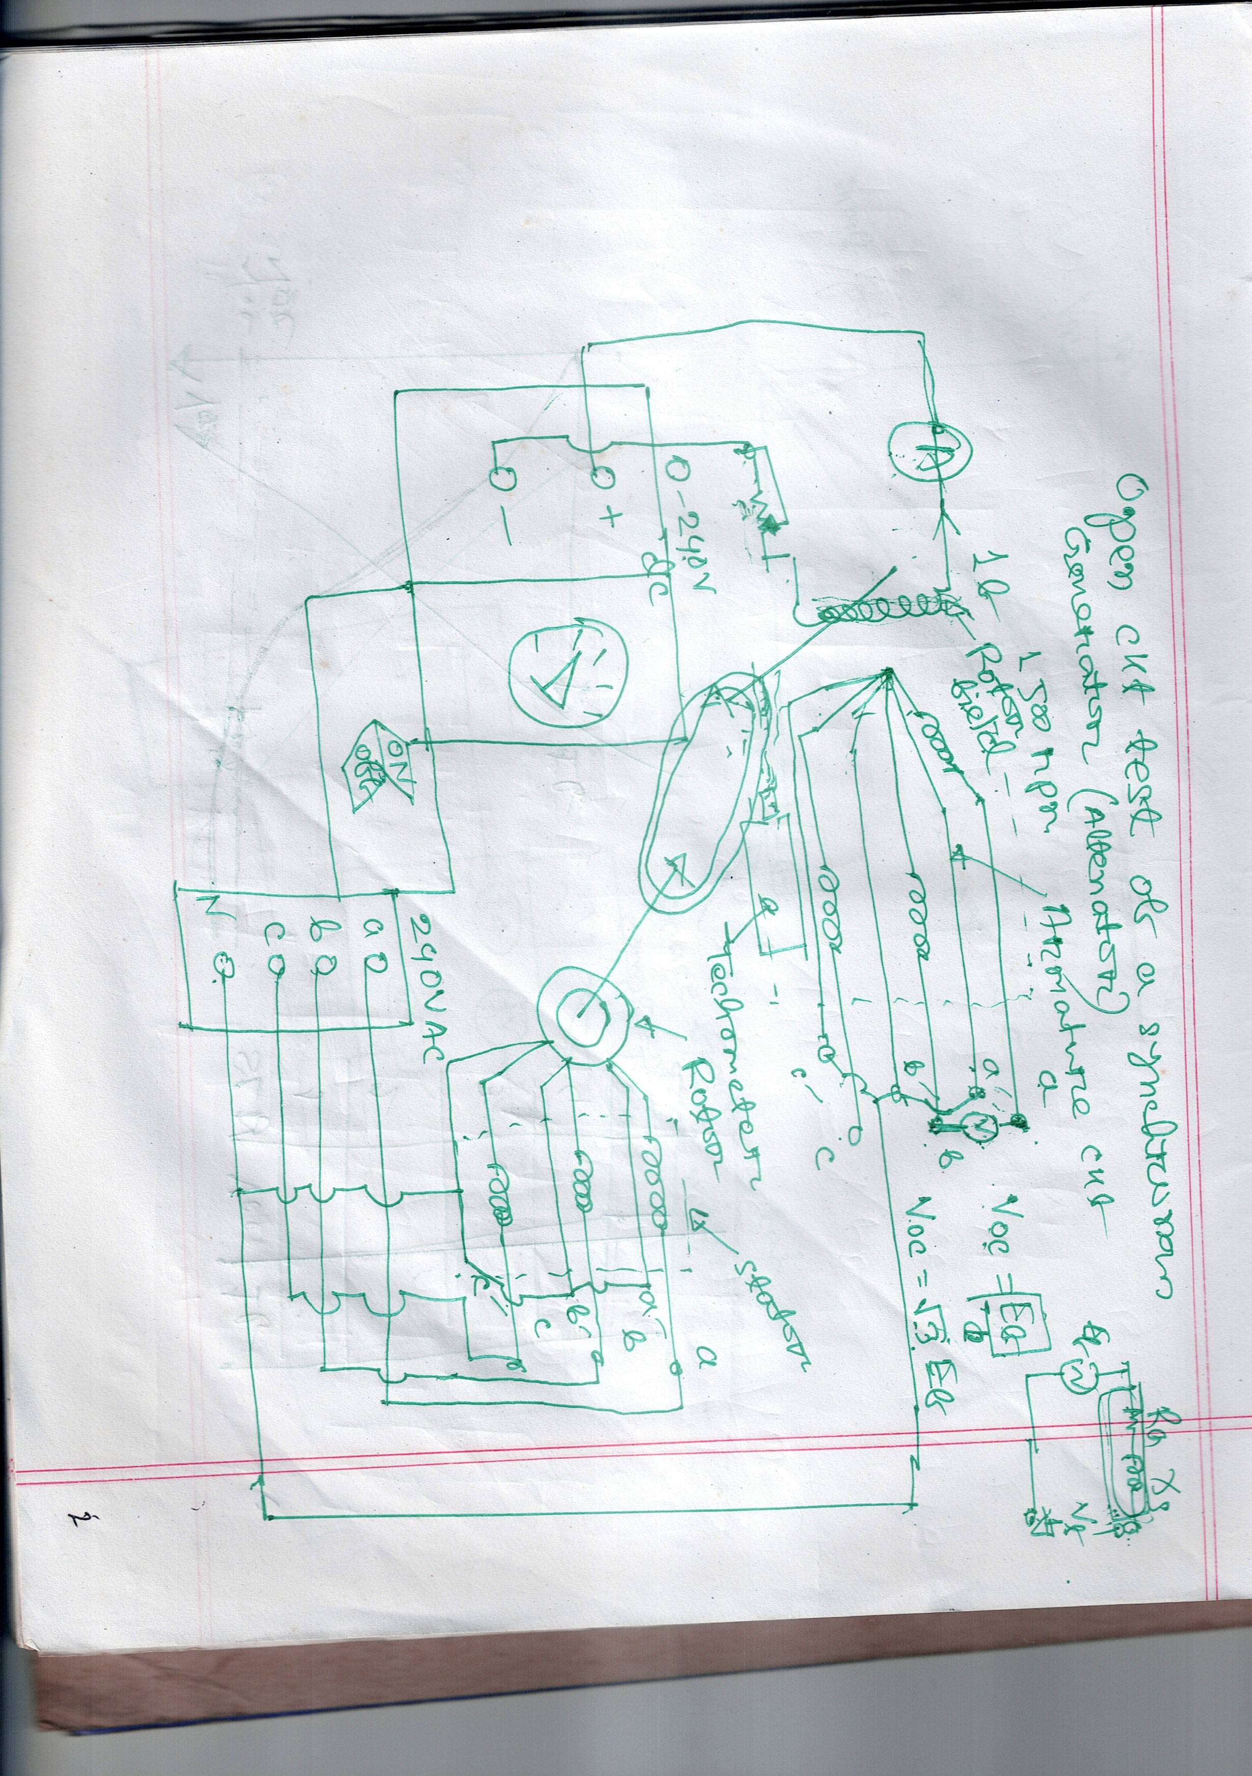
OCC test of a synchronous generator.

Slide 6
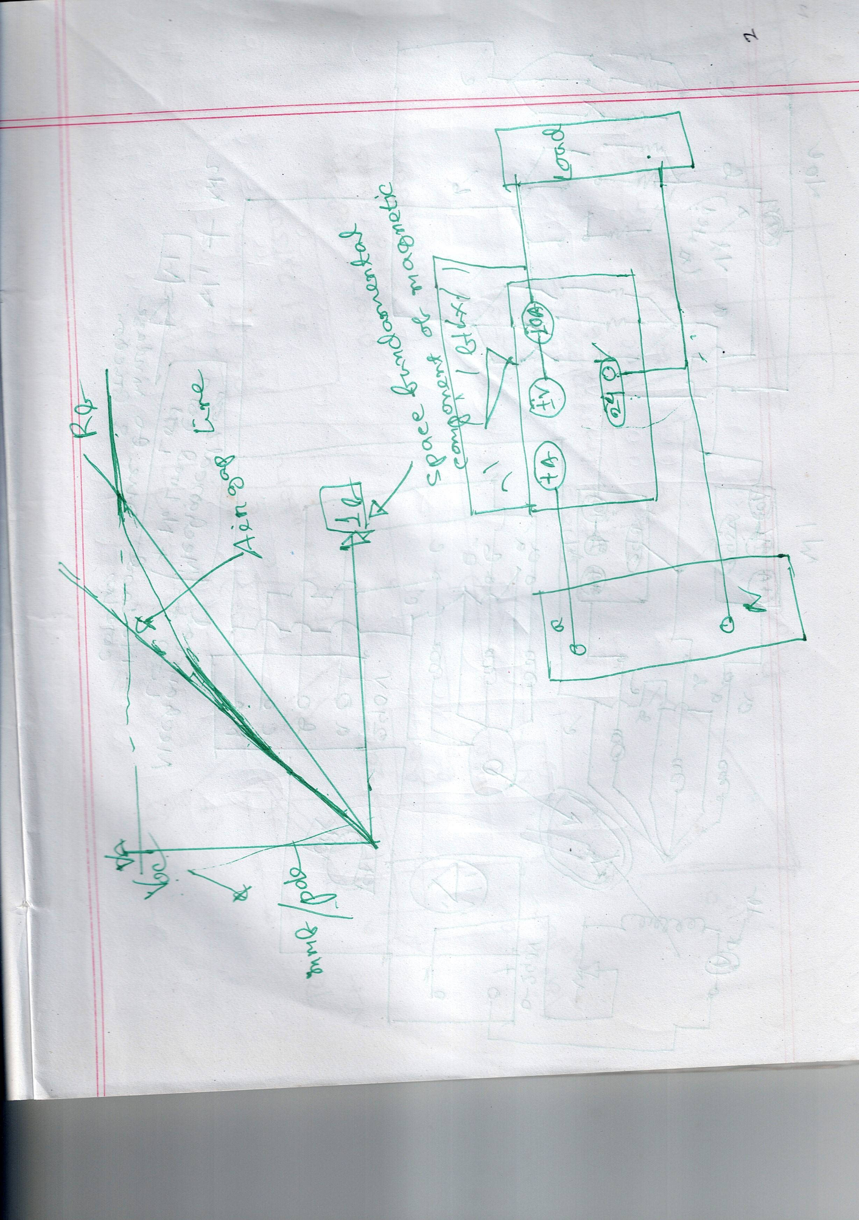
Determination of core Loss

Slide 7
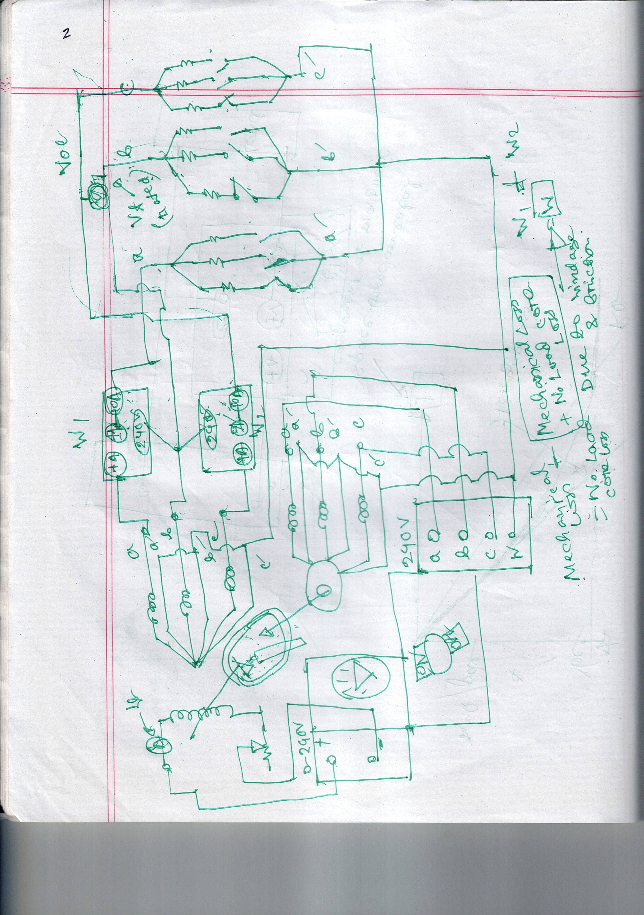

Slide 8
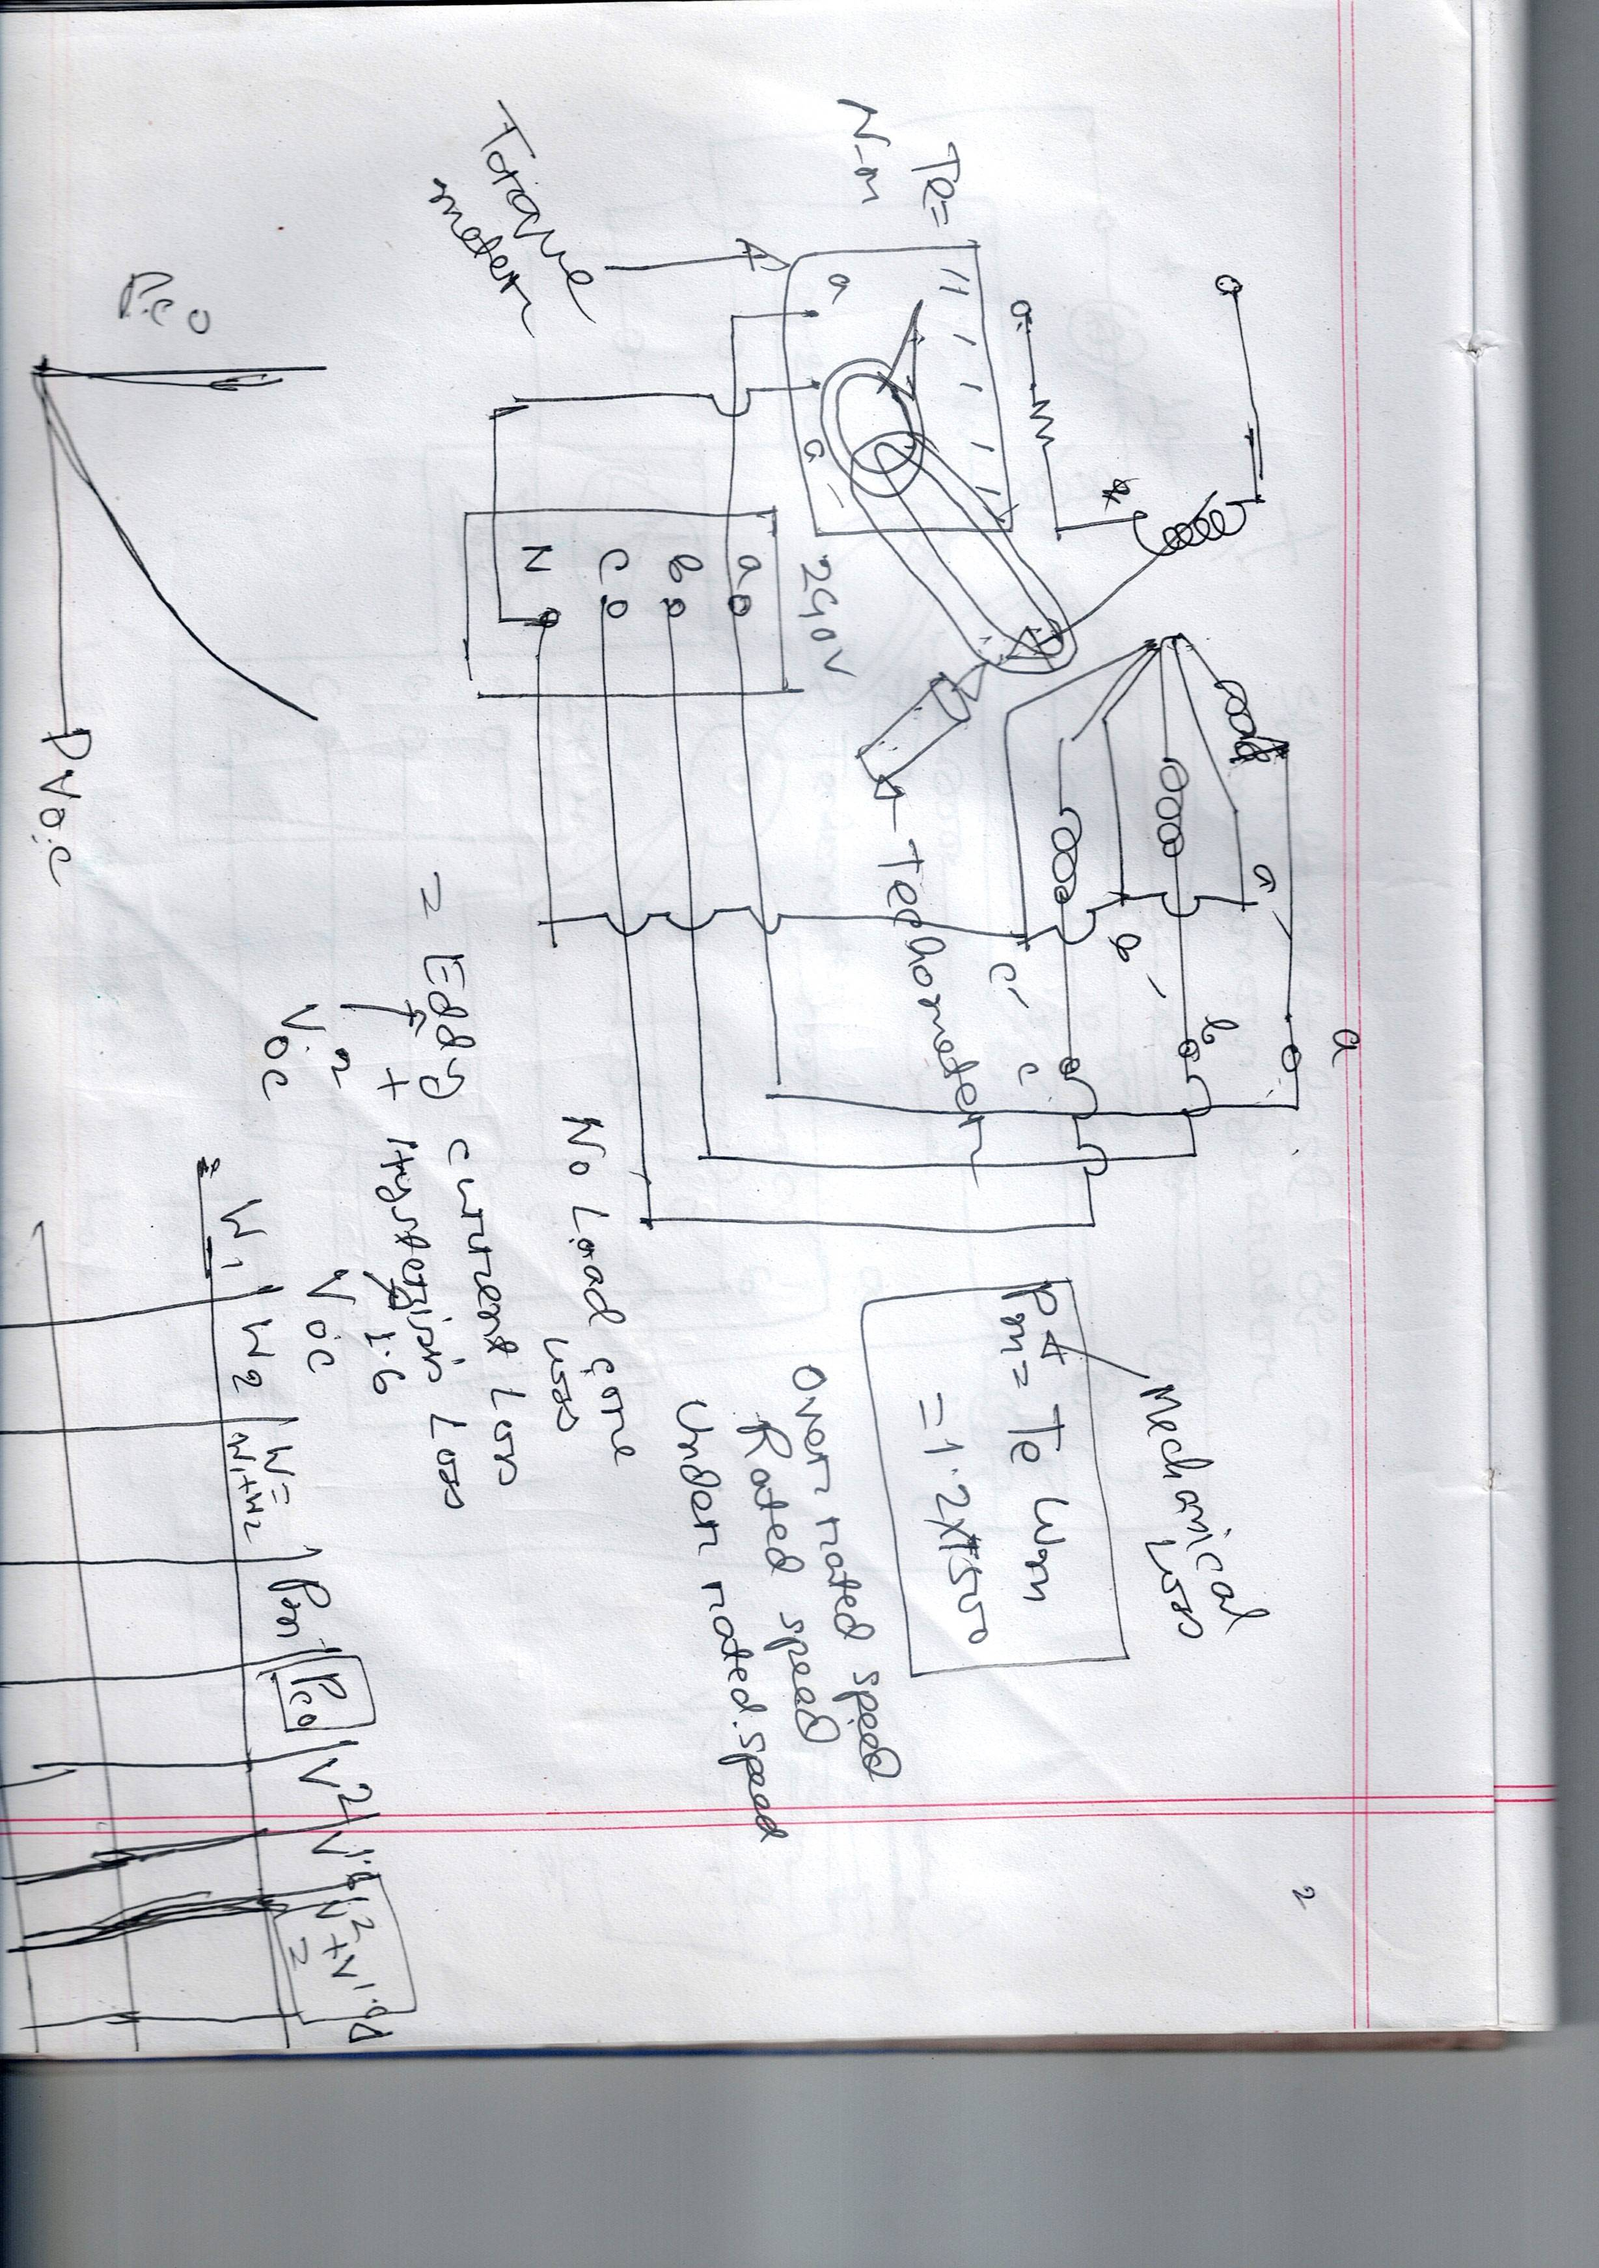
SC Test of synchronous generator

Slide 9
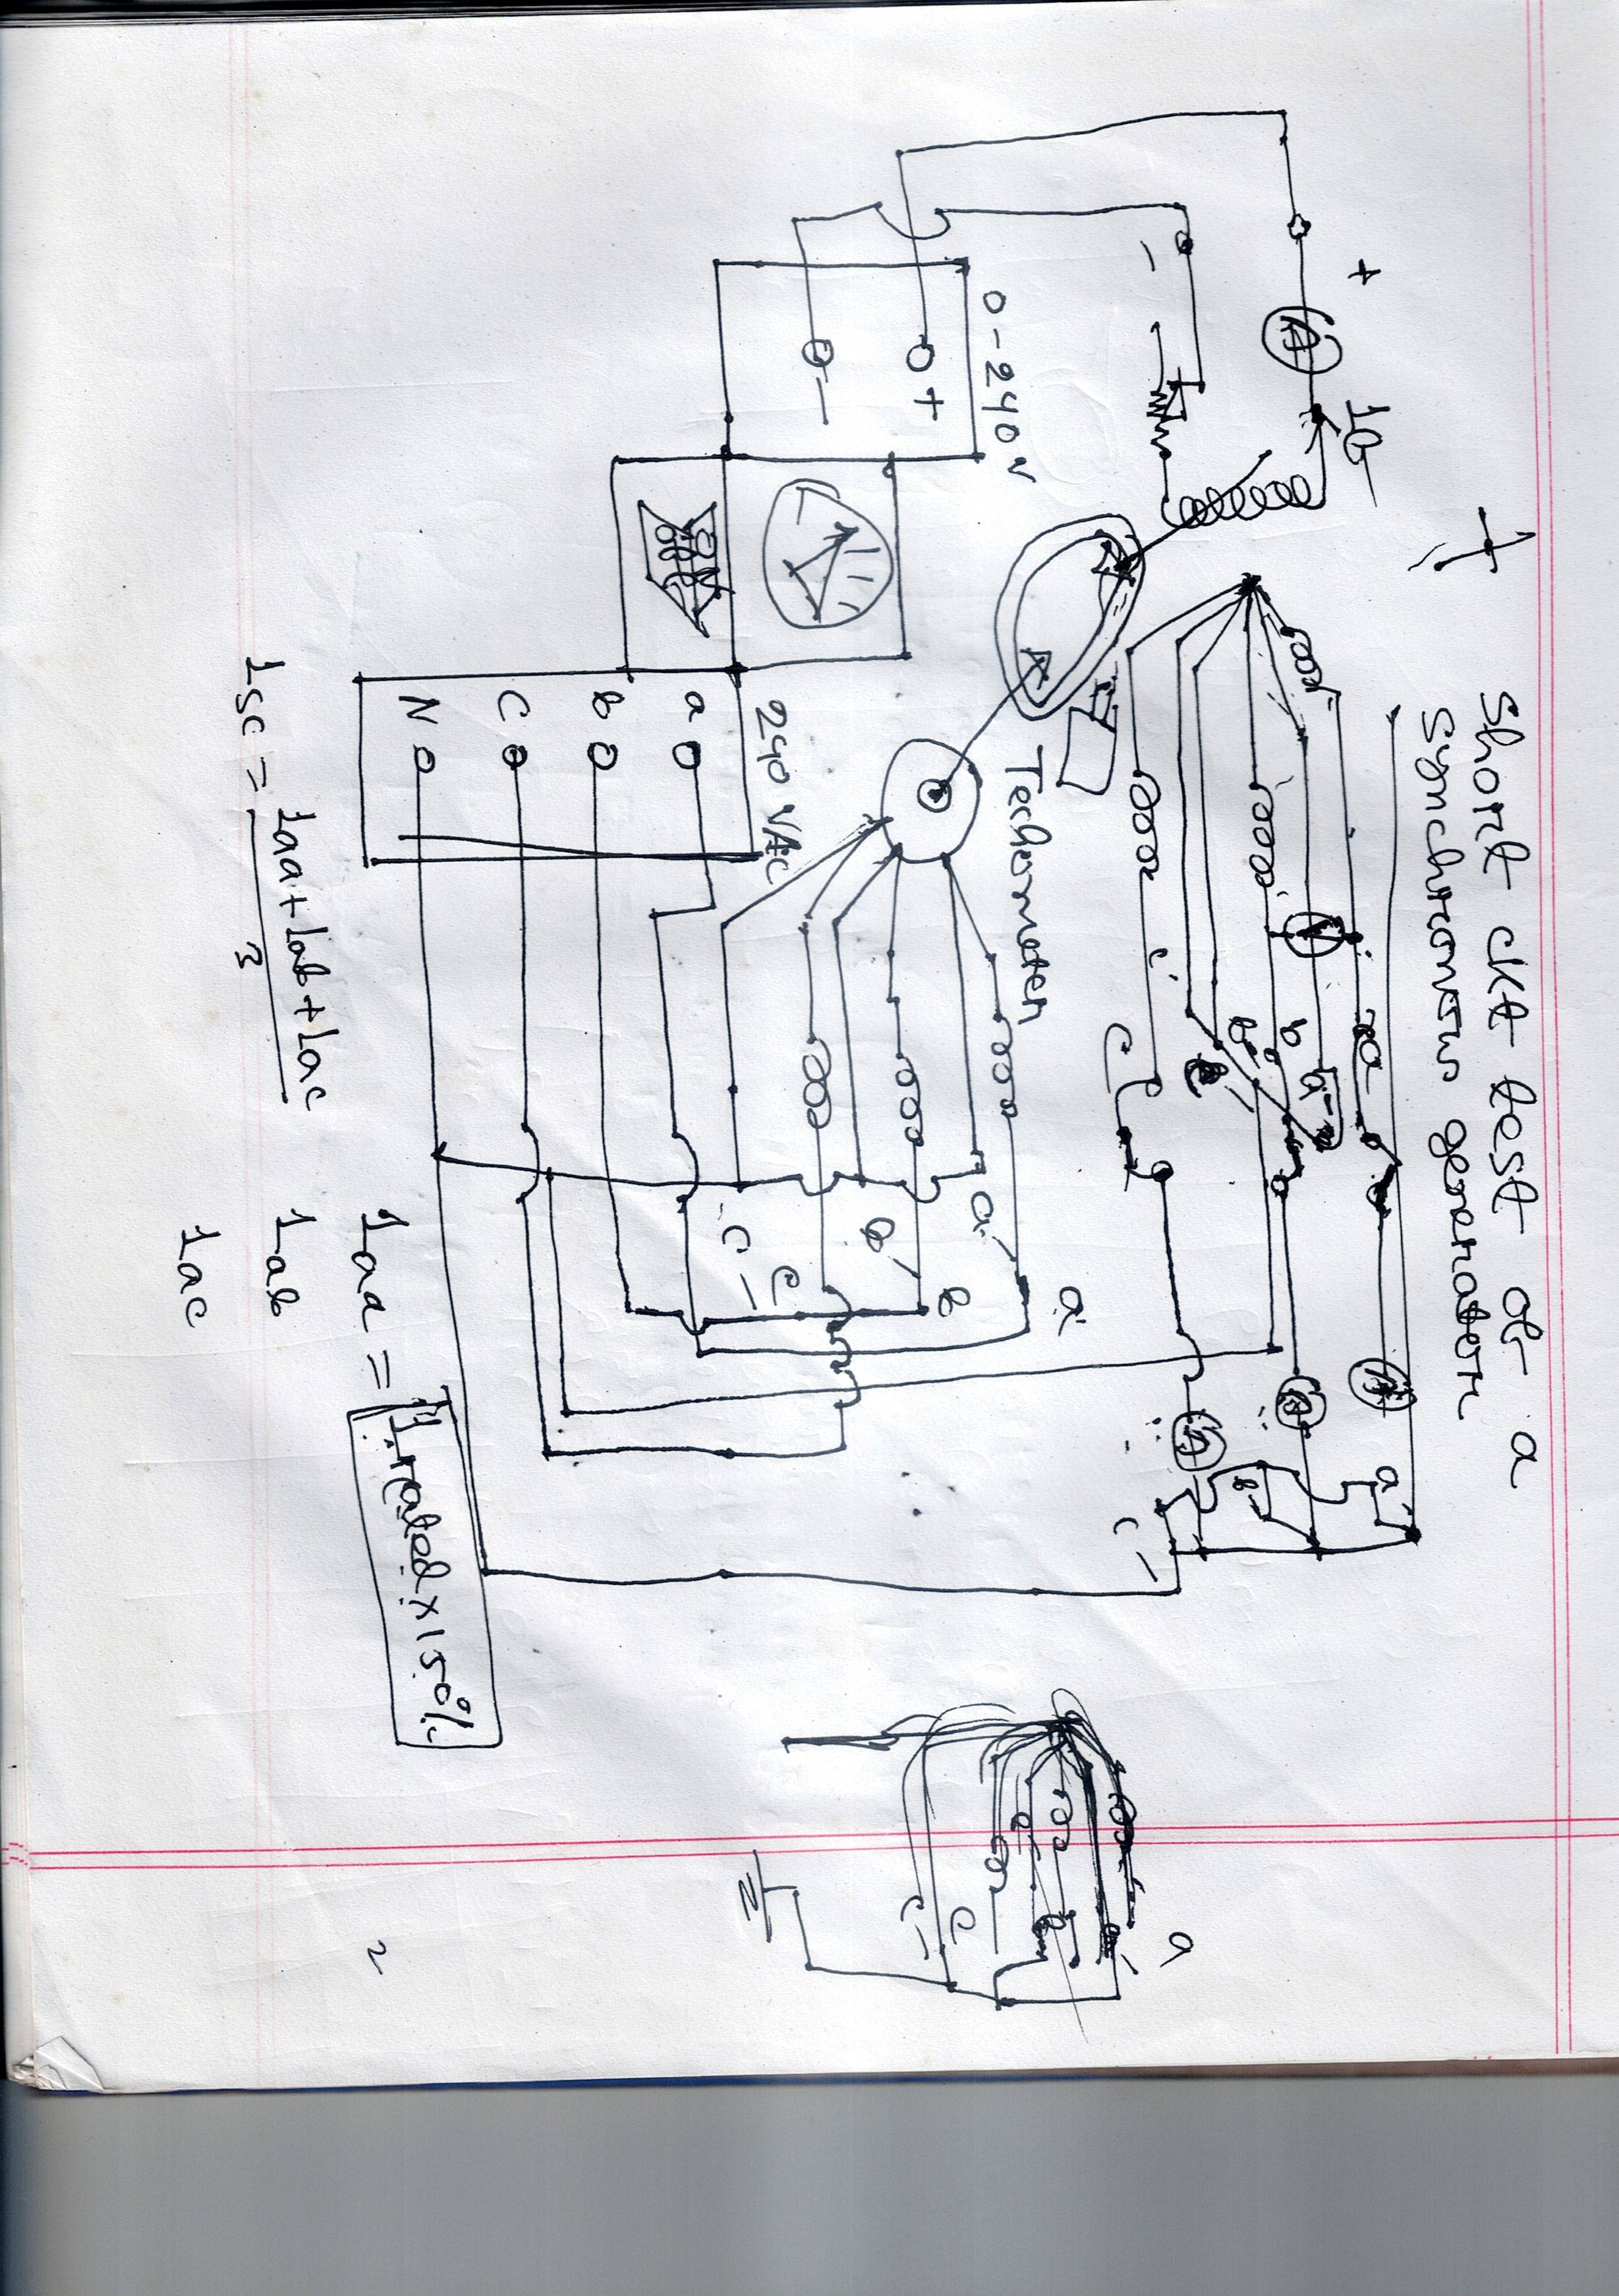

Slide 10
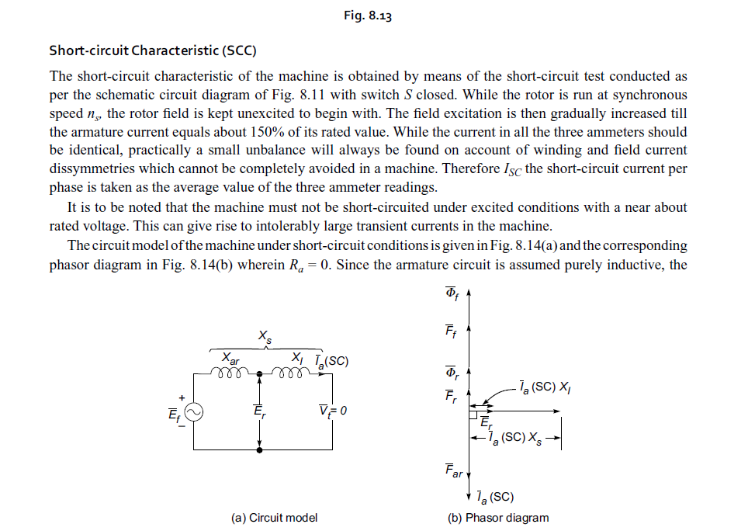
Demagnetizing effect of armature reaction during SCC Text

Slide 11
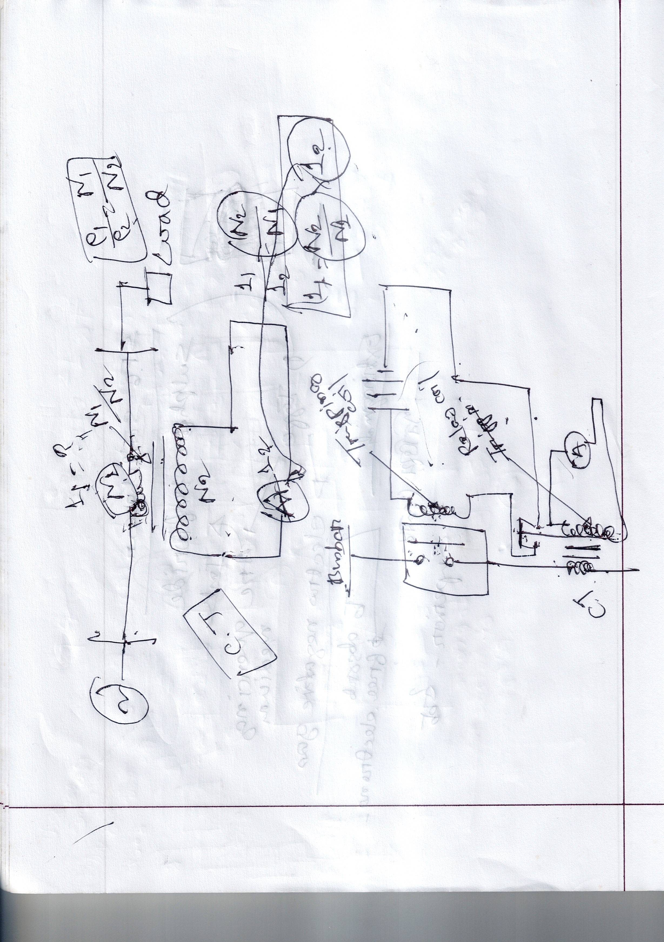
Concept of power protection techniques using switchgear.

Slide 12
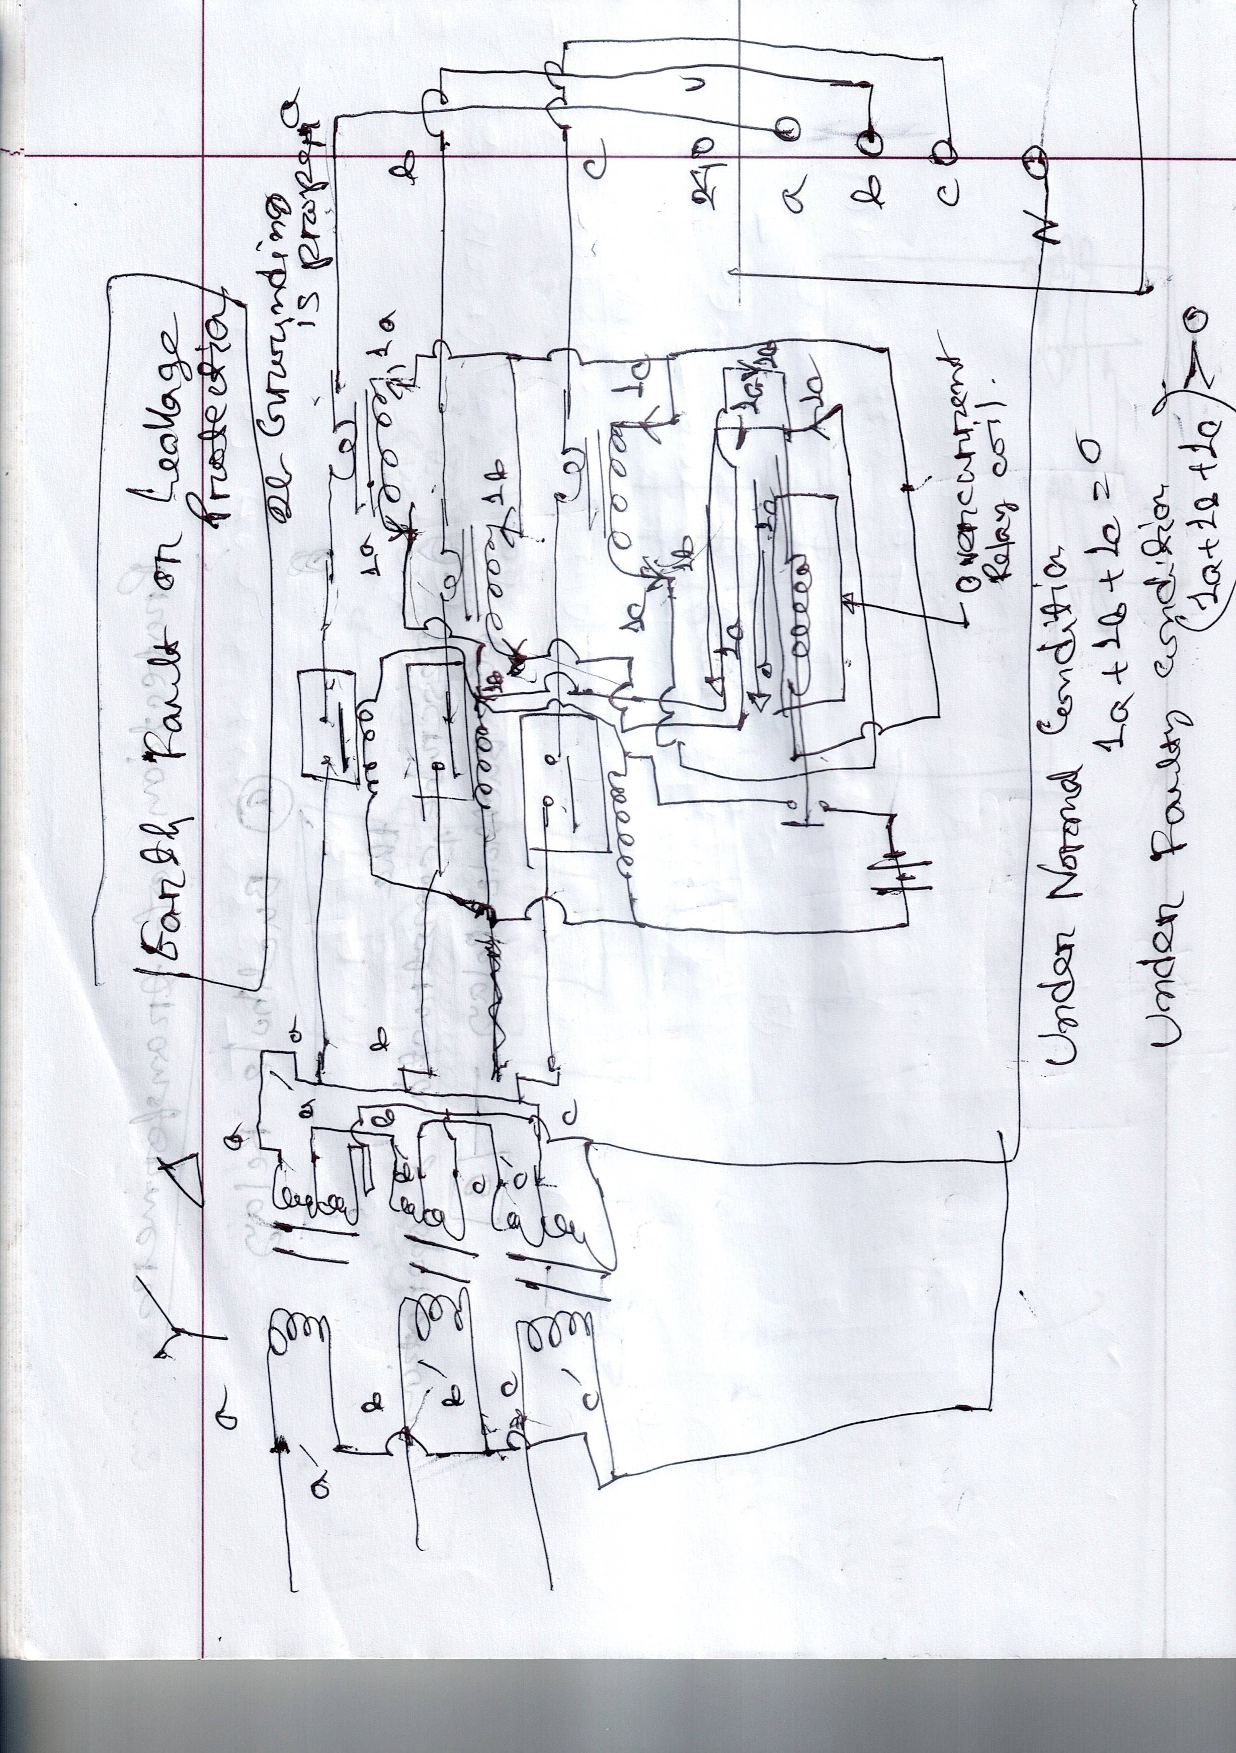
Earth Fault or leakage protection

Slide 13
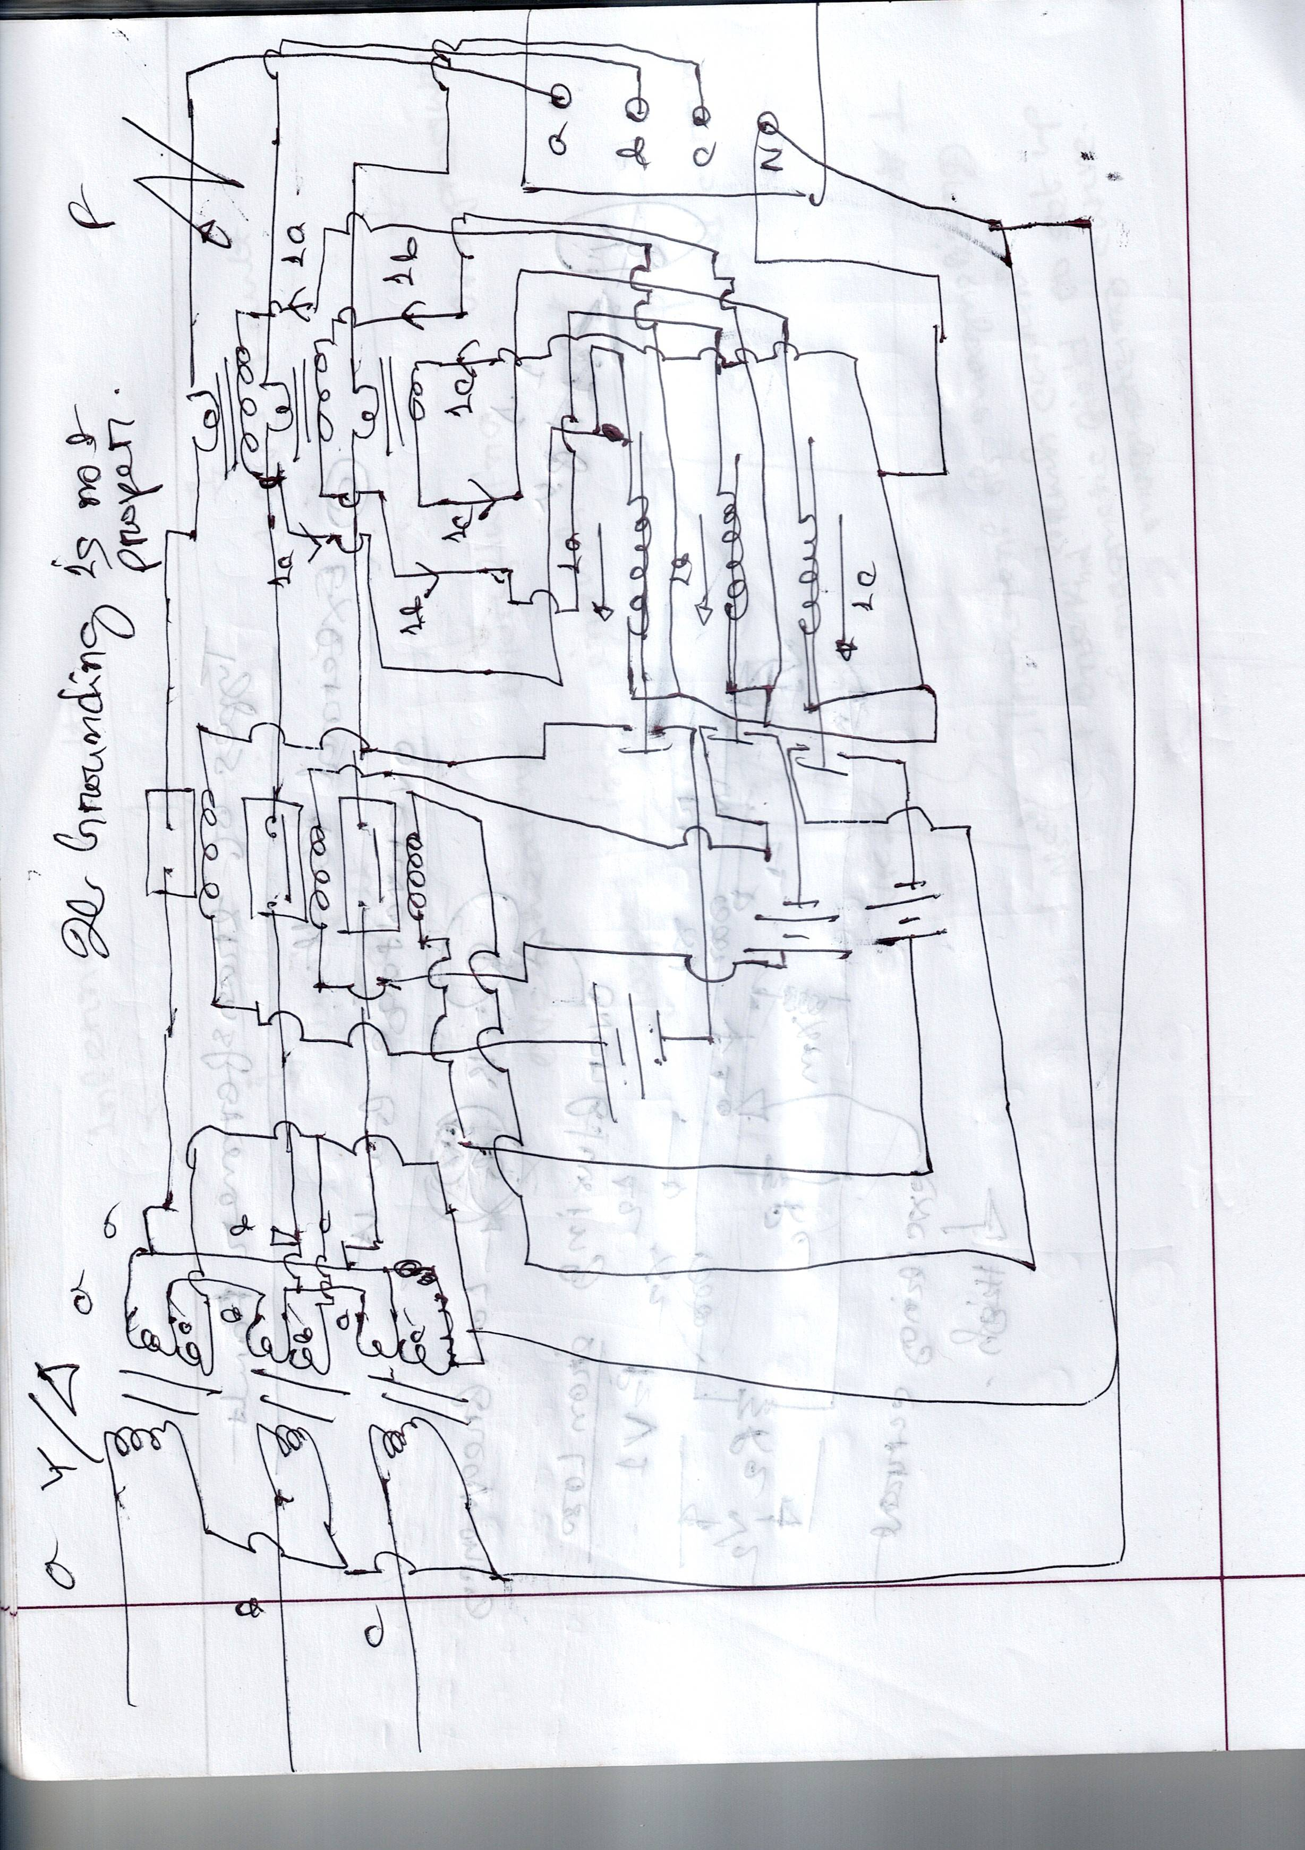
Combined Leakage & overload protection.

Slide 14
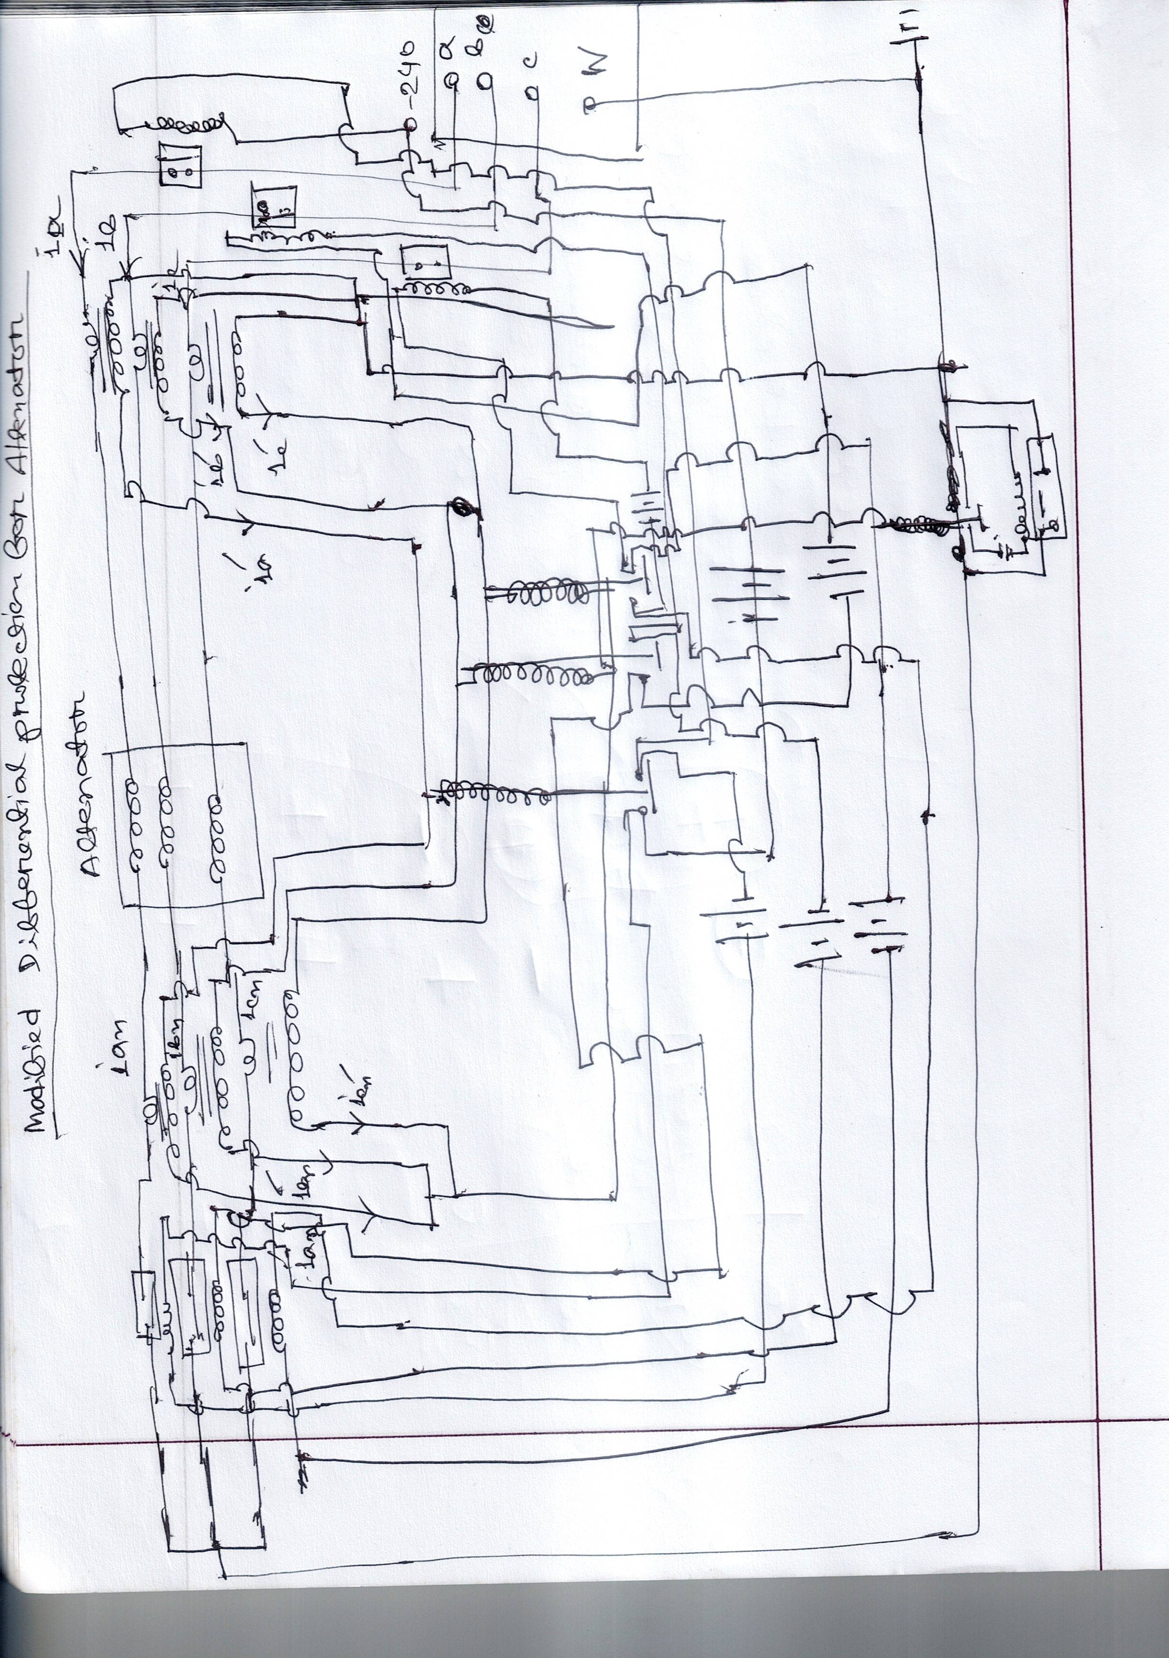
Modified differential protection for alternator

Slide 15
Protection precautions:
Overvoltage transients are protected against by surge protective device. This condition occurs overfluxing of the transformer & an increase in stress on the winding insulation. Overfluxing increases iron losses and may result in a large increase in exciting current. Such conditions result in rapid heating of the iron circuits of the transformer at low frequencies. The ratio of voltage to frequency should not be allowed to exceed 1.1 per cente.
Internal faults are divided into two classifications- (a) incipient faults (b) active faults. Incipient faults are of three kinds: (a) overheating (b) overfluxing © overpressure. Incipient faults are developed slowly but will be becoming major types if the cause is not detected & corrected.
Active faults are caused by the break down in insulation or other components that require prompt action to limit the damage & prevent further destructive action.
When a transformer is first energized, there is a transient inrush of current that is required to establish the magnetic field of the transformer. This does not cause protective relays to operate. Under certaom cpmdotopms. De[emdomg pm the resodia; f;ix om the tramsfpr,er cpre, the magnitude of the inrush current can be as great as eight to ten times normal full load current & can be the cause of false tripping of the protective relays.

